Slide 1

George S. & Stella M. Knight Essay Contest
Overview of Contest Rules and Deadlines
SAR Atlantic Middle States Conference
August 12-13, 2011

Slide 2
History and Background
The George S. and Stella M. Knight Essay Contest was originally established and named in honor of President Calvin Coolidge, who won a local SAR essay contest while a student at Amherst. The contest was reestablished in 1988 by Compatriot McCarthy DeMere. In 1995, the contest was renamed the George S. and Stella M. Knight Essay Contest in honor of their generous gift to the SAR to support this contest. The program is designed to give students an opportunity to explore events that shaped American history.
Conducted at the Chapter, State Society and National Society levels, the students must submit an original essay with topics based on original research and deal with an event, person, philosophy or ideal associated with the American Revolution, Declaration of Independence, or the framing of the United States Constitution.

Slide 3

Purposes and Goals
Why do we sponsor this contest?
● To recognize outstanding youth in your area and in the nation.
● To obtain publicity for the SAR in your local community.

Slide 4
Recruiting Contestants
● Personal contact with a high school history, social studies or English teachers who may be able to assist you in identifying potential competitors.
● Letters/brochures to local high schools (sample on next slide).
● Children/grandchildren of local SAR and DAR members.
● Local Children of the American Revolution (CAR) societies.
● Notices on website, social media.

Slide 5
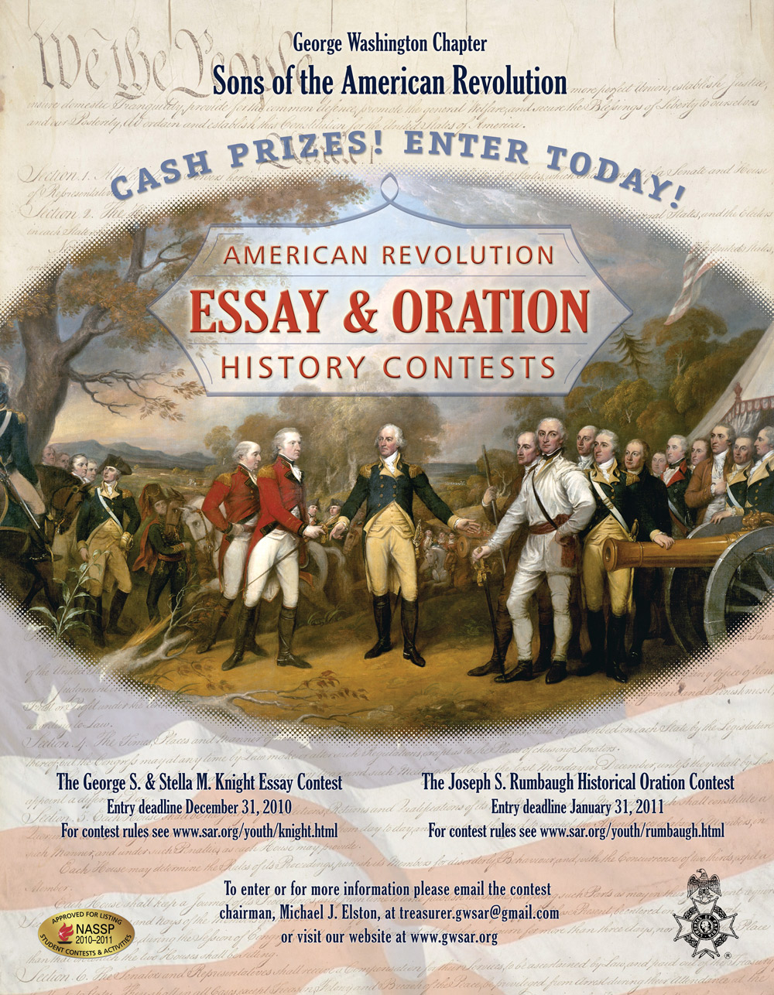
Recruiting Contestants

Slide 6
Knight Essay Contest
Stage 1: The Chapter-Level Contest
Eligibility: Sophomores, juniors or seniors attending public, parochial, or private high schools (including accredited home schools) who are United States citizens or legal aliens. Only one entry per student per contest year.
Deadline: Chapter’s option (December 31 recommended).
Submission: an original researched and proven topic written in English. The topic of the essay shall deal with an event, person, philosophy, or ideal associated with the American Revolution, the Declaration of Independence, or the framing of the United States Constitution.

Slide 7
Knight Essay Contest
Stage 1: The Chapter-Level Contest (continued)
Essay Requirements: (A) title page, (B) essay pages, (C) bibliography (works cited), and (D) contestant's biography. The title page, bibliography and contestant's biography must be listed on separate pages and no reference to the contestant's name or information can be part of the Essay pages or Bibliography.
Title Page: title of the essay, contestant's name, address, telephone number, and email address (if available); name, address, and telephone number of the high school in which the contestant is enrolled, and the contestant's grade level

Slide 8
Knight Essay Contest
Stage 1: The Chapter-Level Contest (continued)
Essay Pages:
● Minimum of 800 words; maximum of 1200 words.
● The essay title must appear on the first page (as well as the Title Page).
● The essay must be typed double-spaced on white bond paper.
● No bindings or special covers are needed.
● Graphics are not permitted. An original copy of the essay must be submitted.
● Poor quality copies will not be accepted.
● Plagiarism will be grounds for immediate disqualification.

Slide 9
Knight Essay Contest
Stage 1: The Chapter-Level Contest (continued)
Bibliography:
● At least 5 references; 3 must be from published book sources (i.e., not encyclopedias or Internet sites). If there are no book sources, the essay will be disqualified.
● The essay and bibliography must be documented in accordance with the Modern Language Association publication, MLA Handbook for Writers of Research Papers (see www.mla.org) or Kate L. Turabian's publication, A Manual for Writers of Term Papers, Theses, and Dissertations.

Slide 10
Knight Essay Contest
Stage 1: The Chapter-Level Contest (continued)
Contestant’s Biography:
● The contestant's biography is limited to one page.
● Topics to be included in the biography are academic awards and achievements, school activities, community activities, and plans for college.

Slide 11
Knight Essay Contest
Stage 1: The Chapter-Level Contest (continued)
JUDGING CRITERIA
● Historical accuracy
● Clarity of thought
● Organization and proven topic
● Grammar and spelling
● Documentation

Slide 12
Knight Essay Contest
Stage 1: The Chapter-Level Contest (continued)
PRIZES and AWARDS
● Chapter’s Discretion
● Cash is King: students are looking for college $$$
● Recommendation: cash award, medal and certificate
● Certificate of participation available for all contestants

Slide 13
Knight Essay Contest
Stage 2: The State-Level Contest
Deadline: The state contest deadline should be set after the chapter deadline but far enough in advance of a state meeting so the winner(s) can be present. If the contest is not conducted at the chapter level in your state, the recommended deadline is December 31.
Prizes and Awards: State should recognize top three essay contestants with cash award. Winner should also receive a state-level medal and certificate. Virginia’s cash awards are $1000, $500, and $300.

Slide 14
Knight Essay Contest
Stage 3: The National Contest
Deadline: Set by the national contest chairman.
Prizes and Awards:
First place: $2,000; a winning recognition certificate and medal; airfare and one night hotel stay for the winner and a chaperone at the SAR Annual Congress; publication of essay in the SAR Magazine and on the SAR website.
Second Place: $1,000
Third Place: $500

Slide 15

Knight Essay Contest
Congratulations to
Amanda Schanz
2011 National Knight Essay
Contest Winner
Math & Science High School at Clover Hill, Midlothian, VA
Sponsored by the Richmond Chapter

Slide 16
Knight Essay Contest
Questions?
Contact Mike Elston, VASSAR Knight Essay Contest Chair
(703) 680-0866 or elston@alumni.duke.edu or treasurer.gwsar@gmail.com

